Slide 1
Understanding Computer Viruses:
A computer virus is a malicious software program designed to infiltrate and damage computer systems. Viruses can replicate and spread to other devices, often without the user's knowledge or consent. Understanding how they work is crucial for keeping your devices safe.

Slide 2
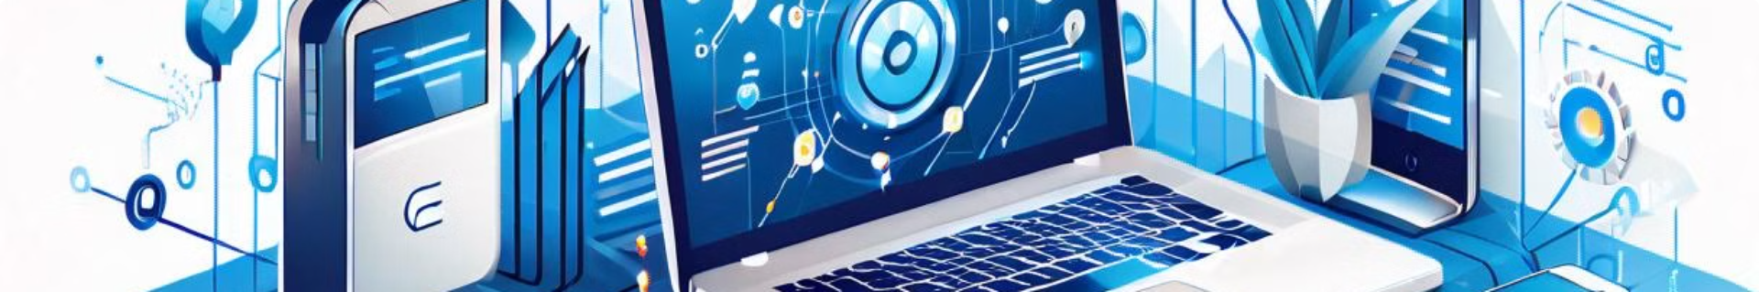
How Viruses Spreads:
Email Attachments
Infected USB Drives
Viruses can be hidden in email attachments, tricking users into downloading and executing the malicious code.
Plugging in an infected USB drive can allow the virus to spread to the connected computer.
1
2
3
Infected Websites
Visiting compromised websites can lead to the installation of viruses through exploits or drive-by downloads.

Slide 3
Common Types of Viruses
Trojans
Worms
Ransomware
Trojans disguise themselves as legitimate software to gain access to your system and cause damage.
Worms are self-replicating viruses that can spread rapidly through networks without user interaction.
Ransomware encrypts your files and holds them for ransom, demanding payment to regain access.

Slide 4
Symptoms of virus infected computer:
1
Slow Performance
2
Unexpected Crashes
A virus can consume system resources, leading to sluggish performance and lagging programs.
Viruses can cause system instability, leading to frequent software crashes and freezes.
3
Strange Behavior
4
Unauthorized Changes
Viruses may cause your computer to display unusual error messages, pop-ups, or other unexpected behavior.
Viruses can modify system settings, delete files, or create new programs without your consent.

Slide 5

Preventing Virus Infections
Keep Software Updated
Use Antivirus Software
Reliable antivirus software can detect and block the majority of known viruses and malware.
Install the latest security patches and updates to protect against known vulnerabilities.
Be Cautious Online
Backup Your Data
Avoid downloading suspicious files, and be wary of unfamiliar websites and email attachments.
Regular backups ensure you can restore your files in case of a successful virus infection.

Slide 6
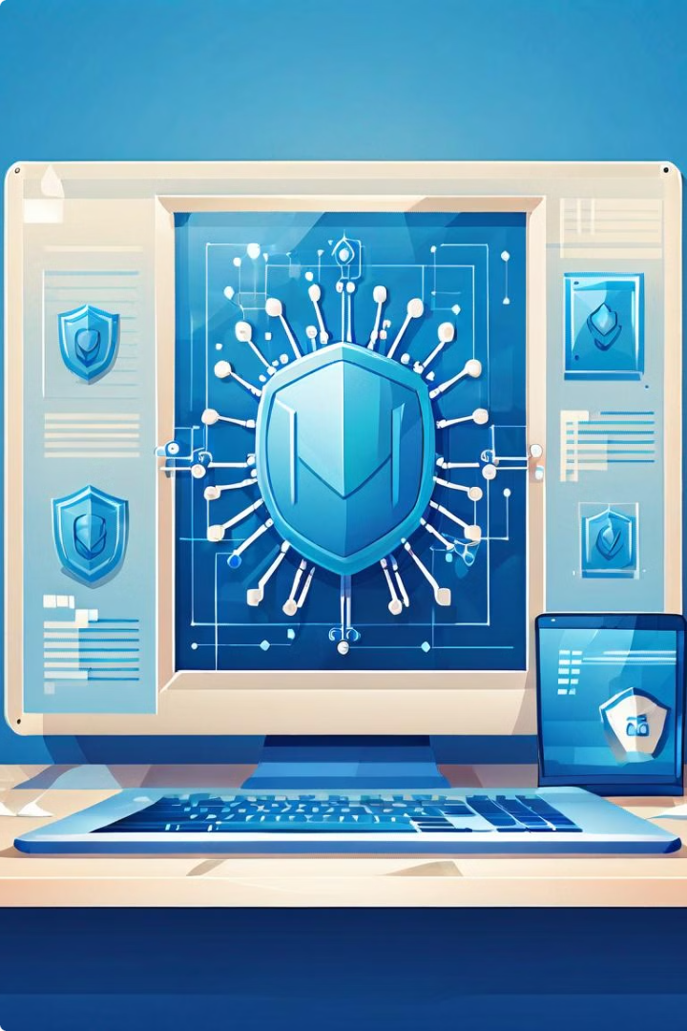



Detecting and Removing Viruses
Scan with Antivirus
Run a full system scan to detect and identify any malicious software on your device.
Quarantine Infected Files
Isolate any infected files to prevent the virus from spreading further.
Remove the Virus
Use the antivirus software's tools to safely remove the virus and restore your system.

Slide 7





Importance of Antivirus Software
Protection
Detection
Removal
Updates
Antivirus software acts as a shield, defending your devices against a wide range of malware threats.
Advanced antivirus programs can quickly identify and isolate new and emerging viruses.
Antivirus tools provide the means to safely remove and clean up infected files.
Regular updates ensure your antivirus software stays ahead of the latest virus threats.

Slide 8

Staying Safe from Viruses
Use Reliable Antivirus
Keep Software Updated
Be Cautious Online
Back Up Your Data

